Slide 1
Modeling Data with Hierarchies and Time Intelligence
Notes:
This module begins by teaching students how to create dimensional hierarchies in the data model of a Power BI Desktop project. The module also discusses the essential DAX topic of evaluation contexts and explains how it affects the way you write your DAX code. Students will learn how to create calendar tables to analyze and report on data in a variety of time dimensions. The second half of the module focuses on the support in the DAX language for writing expressions that provide rich analytic capabilities to calculate year-to-date totals and rolling averages and to provide drill down capabilities to the level of month, week or day.

Slide 2
Agenda
Creating Dimensional Hierarchies
Understanding the Evaluation Context
Extending the Data Model using Calendar Tables
Writing DAX Expressions with Time Intelligence
Writing DAX Code with Contextual Awareness

Slide 3
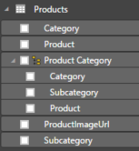
Dimensional Hierarchies
Hierarchy created from two or more columns
All columns in hierarchy must be from the same table
Defines parent-child relationship between columns
Provides path to navigate through data
Provides path to drill down into greater level of detail

Slide 4
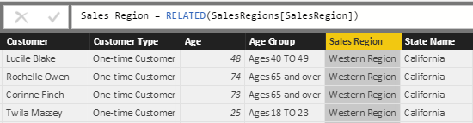
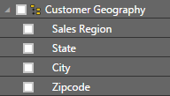
Pulling Columns for Hierarchy into Single Table
Sometimes hierarchy columns are spread across tables
Use RELATED function from DAX to pull columns into single table
Then create hierarchy in the table with all the columns

Slide 5
Agenda
Creating Dimensional Hierarchies
Understanding the Evaluation Context
Extending the Data Model using Calendar Tables
Writing DAX Expressions with Time Intelligence
Writing DAX Code with Contextual Awareness

Slide 6
A Tale of Two Evaluation Contexts
Row Context
Context includes all columns in iteration of current row
Used to evaluate DAX expression in calculated column
Only available in measures with iterator function (e.g. SUMX)
Filter Context
Context includes filter(s) defining current set of rows
Used by default to evaluate DAX expressions in measures
Can be fully ignored or partially ignored using DAX code
Not used to evaluate DAX in calculated columns

Slide 7
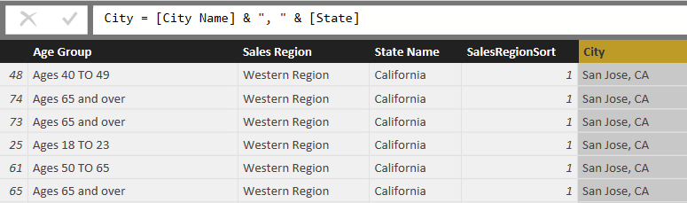
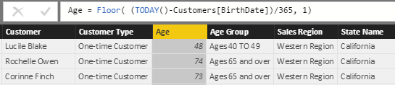
Understanding Row Context
Row context used to evaluate calculated columns

Slide 8

Understanding Iterators Like SUMX
Standard aggregation functions (e.g. SUM) have no row context
You can use SUM to sum values of a single column
You cannot use SUM to sum results of an expressions
Iterator functions (e.g. SUMX) iterate through rows in target table
First argument accepts expressions that evaluates to table of rows
Second argument accepts expression that is evaluated for each row

Slide 9
DAX Table Iterator Functions
The following DAX functions create row context
AVERAGEX
COUNTAX
COUNTX
MAXX
MINX
SUMX

Slide 10
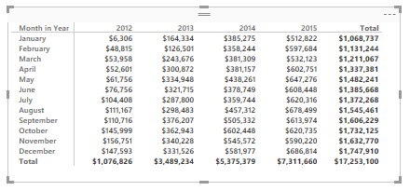
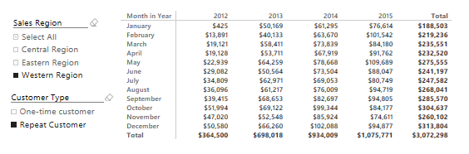
Understanding Filter Context
Visuals apply various filters in different evaluation contexts
Filter context also affected by slicers and other filters
Filters on this evaluation
[Year] = 2015
[Month in Year] = "October"
Filters on this evaluation
[Year] = 2015
[Month in Year] = "October"
[Sales Region] = "Western Region"
[Customer Type] = "Repeat Customer"

Slide 11
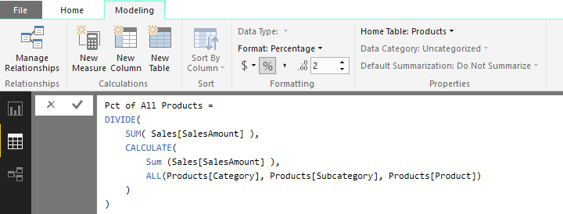
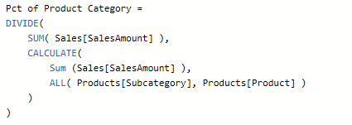
Using the CALCULATE Function
CALCULATE function provides greatest amount of control
First argument defines expression to evaluate
Second argument defines table on which to evaluate expression
You can evaluate expressions with or without current filter context

Slide 12
DAX Functions that Return a Table
ALL
ALLEXCEPT
CALCULATETABLE
DISTINCT
FILTER
RELATEDTABLE
VALUES

Slide 13
Agenda
Creating Dimensional Hierarchies
Understanding the Evaluation Context
Extending the Data Model using Calendar Tables
Writing DAX Expressions with Time Intelligence
Writing DAX Code with Contextual Awareness

Slide 14
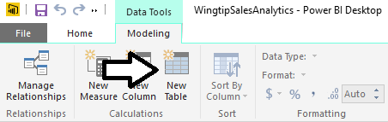
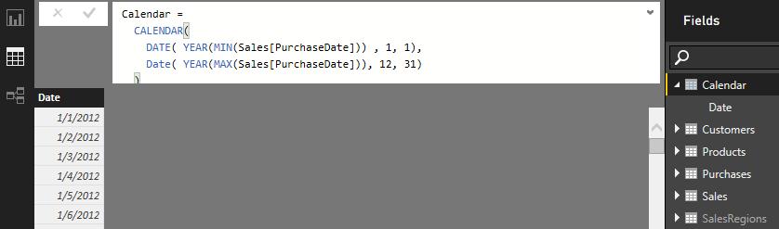
Creating Calendar Table as Calculated Table
Use New Table command in ribbon
Create calendar table using DAX CALENDAR function

Slide 15
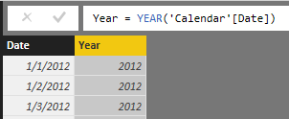
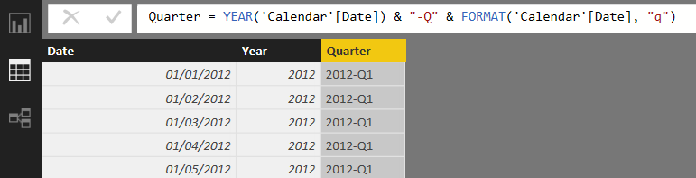
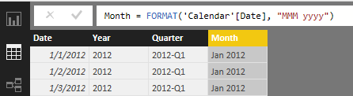
Adding Columns to Calendar Table
Creating the Year column
Creating the Quarter column
Creating the Month column

Slide 16
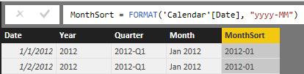
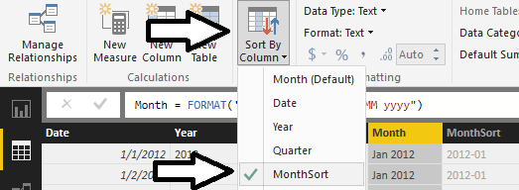
Configuring Sort Columns
Month column will not sort in desired fashion by default
For example, April will sort before January, February and March
Creating a sort column for the Month column
MonthSort sorts alphabetically & chronologically at same time
Configure Month column with MonthSort as sort column

Slide 17
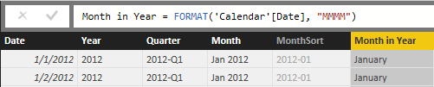
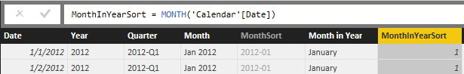
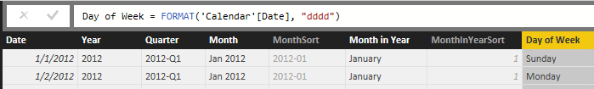
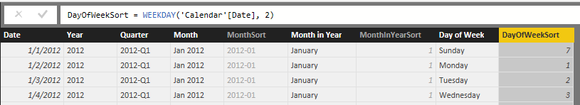
Columns for Month in Year and Day in week
Creating the Month in Year column
Creating the MonthInYearSort column
Creating the Day of Week column
Creating the DayOfWeekSort column

Slide 18
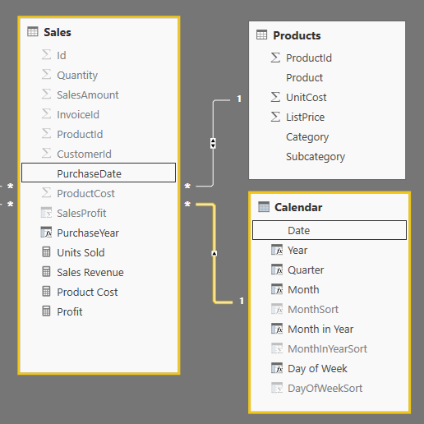
Integrating Calendar Table into Data Model
Calendar table needs relationship to one or more tables

Slide 19
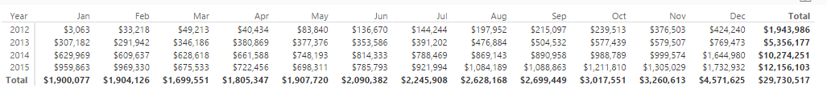
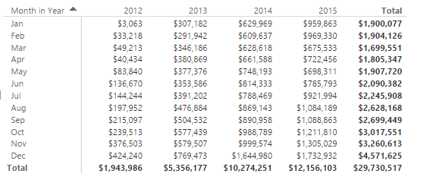
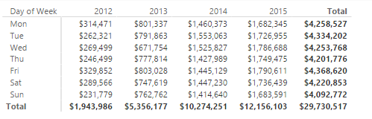
Creating Visuals with a Calendar Table
Year for row labels and Month in Year as column labels
Month in Year for row labels and Year as column labels
Month in Year for row labels and Year as column labels

Slide 20
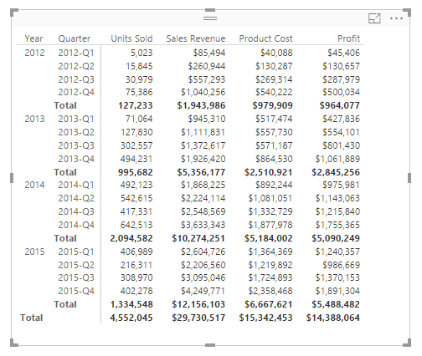
Hierarchical Row Labels in a Matrix
Dimensional hierarchy can be visualized using matrix

Slide 21
Agenda
Creating Dimensional Hierarchies
Understanding the Evaluation Context
Extending the Data Model using Calendar Tables
Writing DAX Expressions with Time Intelligence
Writing DAX Code with Contextual Awareness

Slide 22
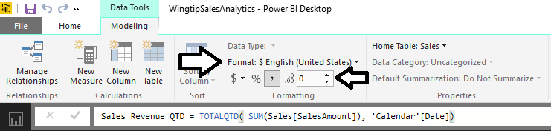
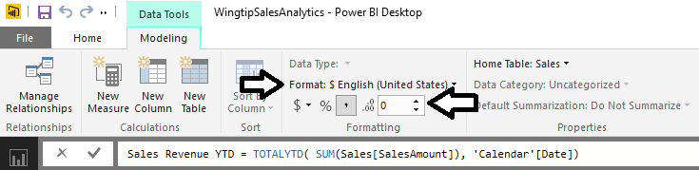
Calculated Fields for QTD and YTD Sales
TOTALQTD function calculates quarter-to-date totals
TOTALYTD function calculates year-to-date totals

Slide 23
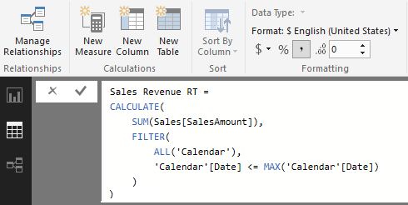
Creating Running Total using CALCULATE
Calculate a running total of sales revenue across years
This must be done using CALCULATE function

Slide 24
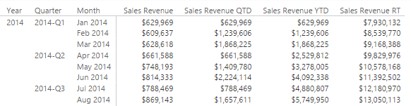
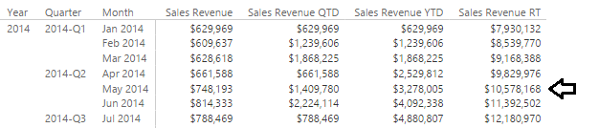
Matrix Visual with To-Date Running Totals
Running totals calculated using DAX
Question: when did Wingtip reach $10,000,000 in sales

Slide 25
Agenda
Creating Dimensional Hierarchies
Understanding the Evaluation Context
Extending the Data Model using Calendar Tables
Writing DAX Expressions with Time Intelligence
Writing DAX Code with Contextual Awareness

Slide 26
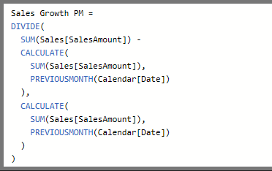
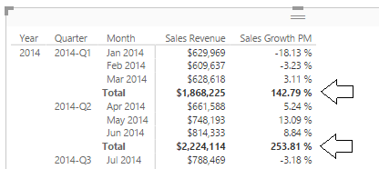
Sales Growth PM Measure - First Attempt
Create a measure named Sales Growth PM
Use measure in matrix evaluating month and quarter
Measure returns correct value when filtered by Month
Measure returns large, erroneous value when filtered by Quarter

Slide 27
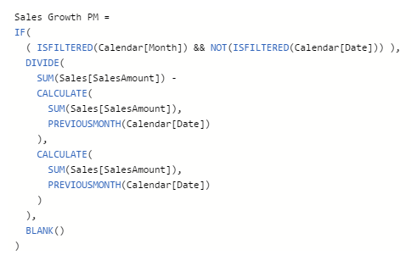
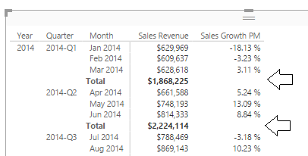
Using the ISFILTERED Function
ISFILTERED function used to determine when perform evaluation
Expression returns Blank value when evaluation context is invalid

Slide 28
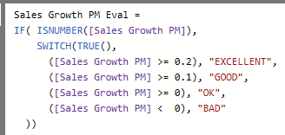
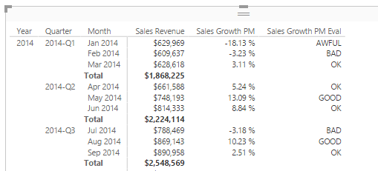
Simulating KPIs with Power BI Desktop
KPIs are not directly support in data model
But you can create something similar using measures

Slide 29
Summary
Creating Dimensional Hierarchies
Understanding the Evaluation Context
Extending the Data Model using Calendar Tables
Writing DAX Expressions with Time Intelligence
Writing DAX Code with Contextual Awareness

